Slide 1
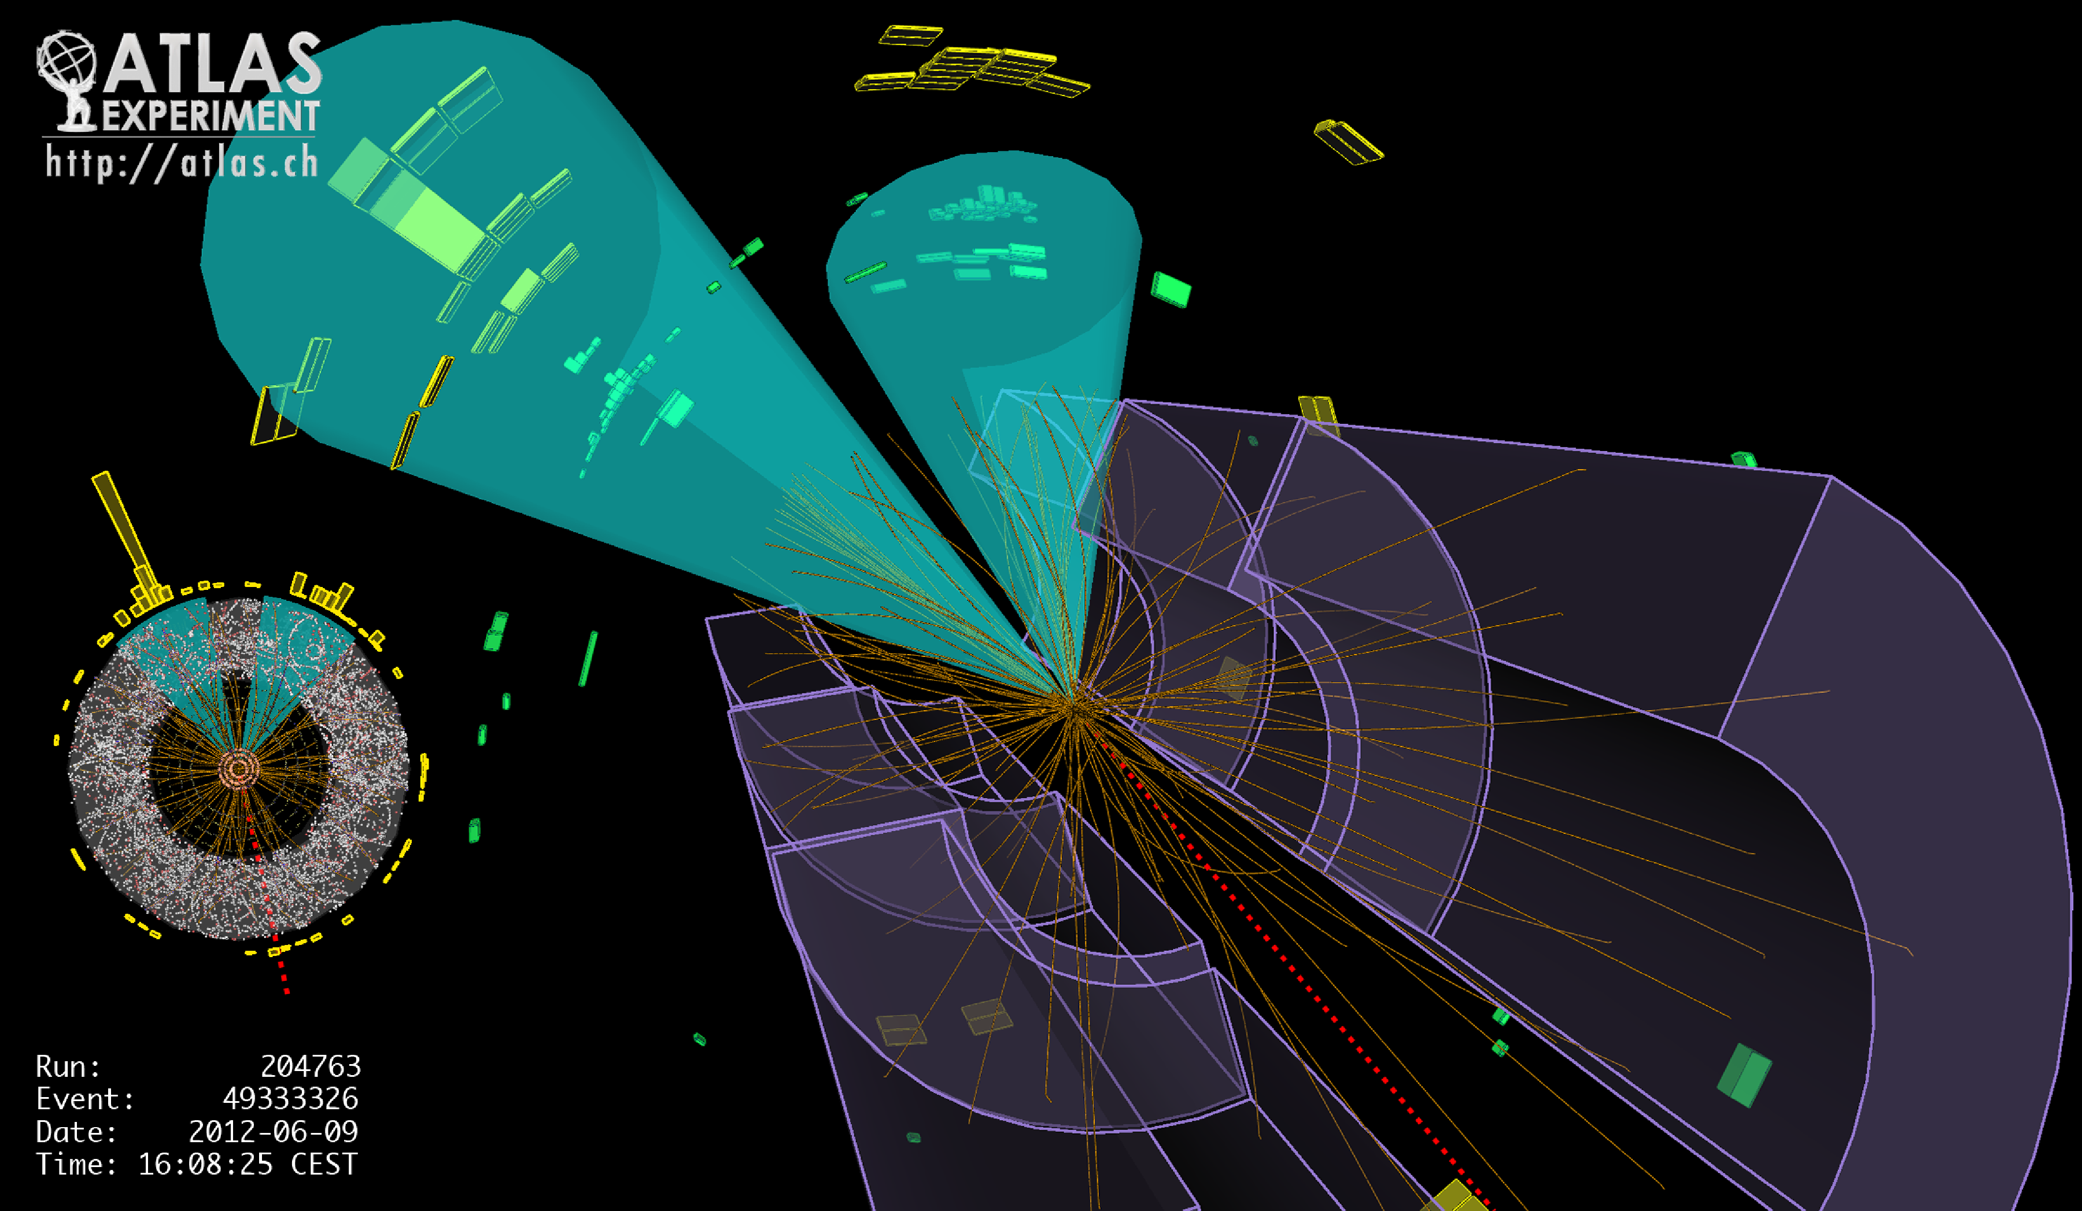
Lecture #1
Prof. Dr. Florencia Canelli
Universität Zürich
Elementary particle physics - PHY451
HS2016
Credits: CERN Summer lectures (di Lella), Hadron collider lectures

Slide 2

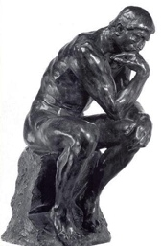
Particle physics
The Aim of Particle Physics
(a.k.a Elementary Particle Physics, or High Energy Physics)
What is everything made of?
2. What holds it all together?
3. How did it all start?

Slide 3
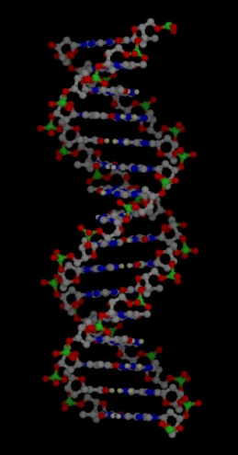
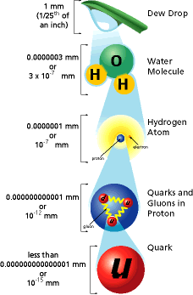

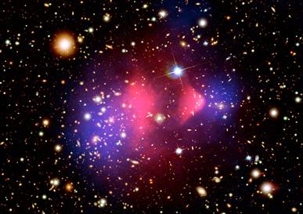
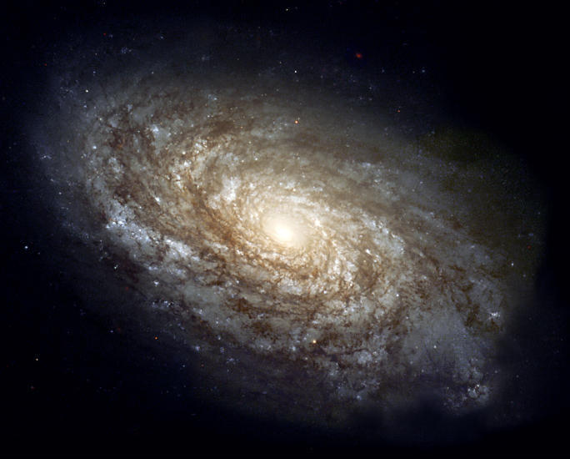
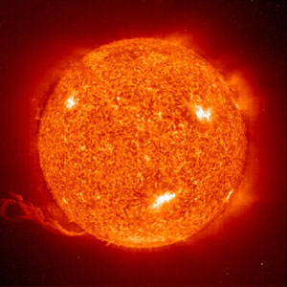
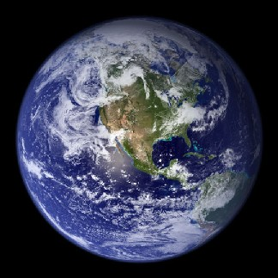
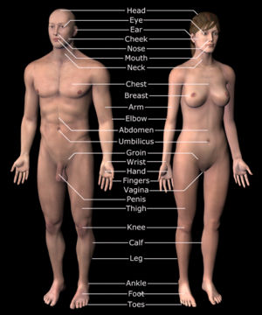
What is everything made of ?
Immense scientific progress in the last 200 years
Quest to answering this question started the fields of chemistry, atomic physics, nuclear physics among others
Experimental tools created to answer this question have produced bold and innovative ideas and technologies which have transformed the way we live

Slide 4
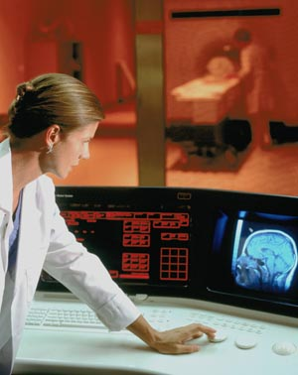
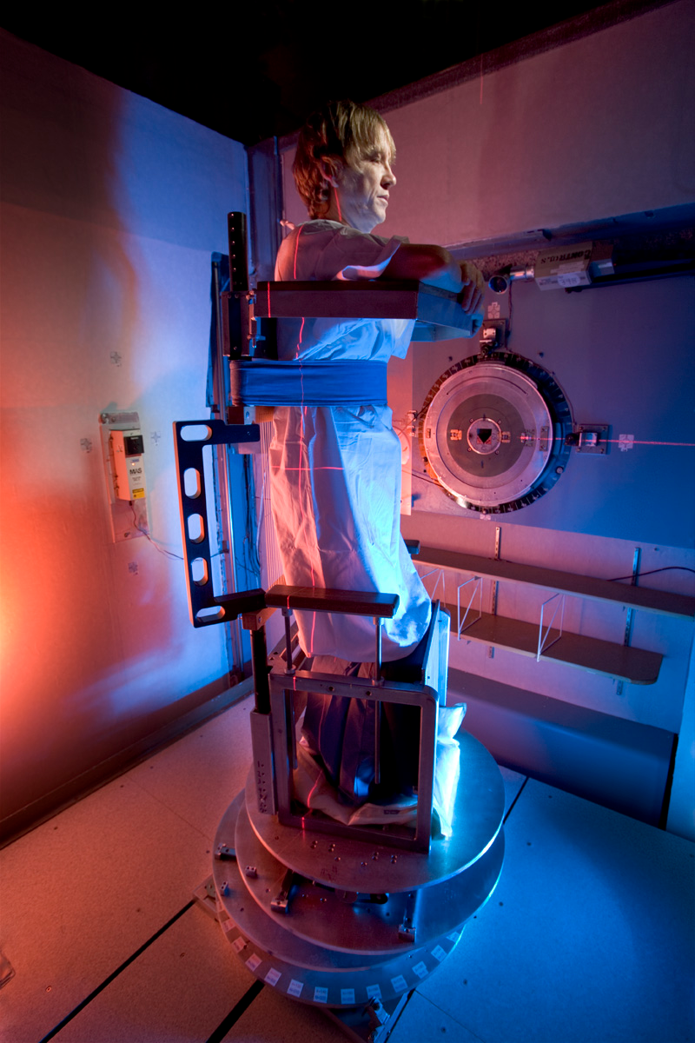
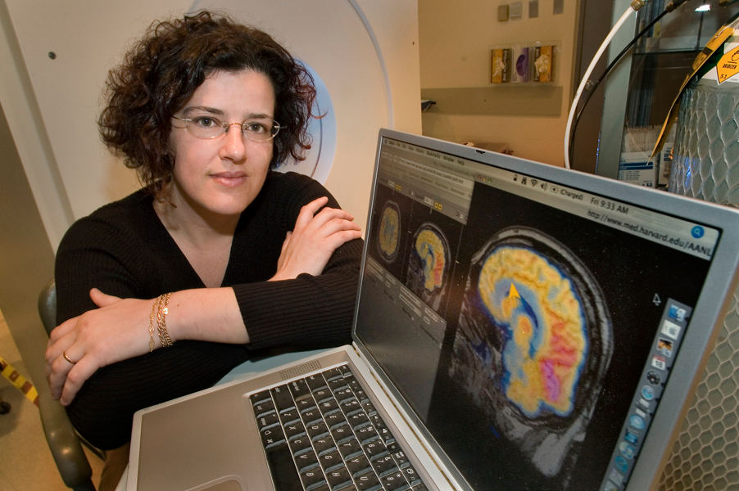
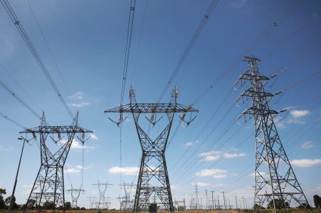

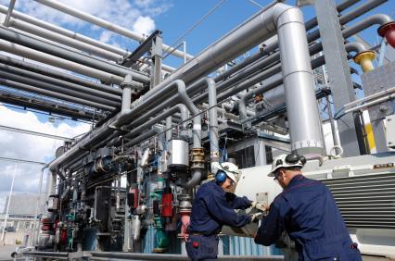


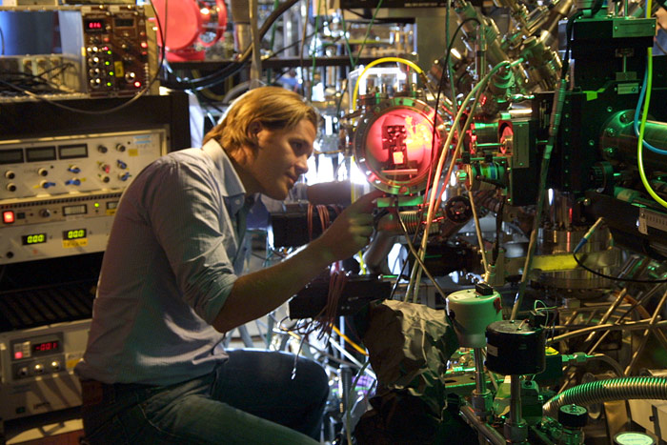
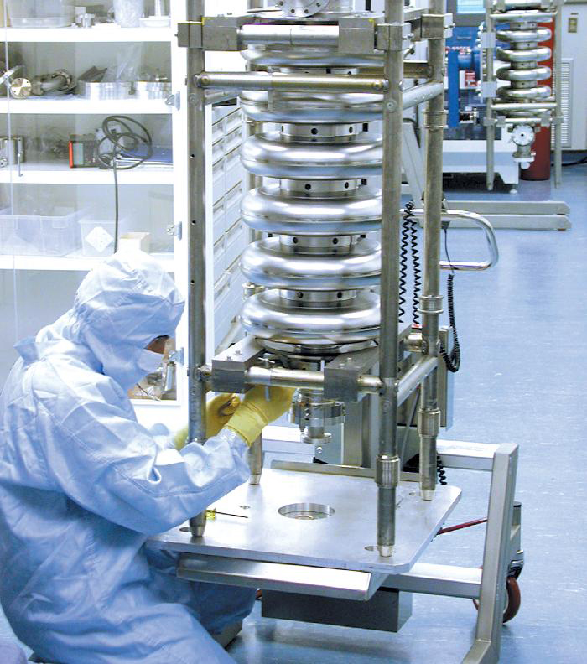

What is everything made of ? – some applications
Medicine
Cancer therapy and diagnosis: x-rays, protons, neutrons, or heavy ions
Magnetic Resonance Imaging: superconducting cable and magnets
Diagnosis instrumentation – PET: photon and tracking detectors
Industry
Power transmission: superconducting cables
Transportation: superconducting magnets
Understanding turbulence
Computing
The World Wide Web
The Grid
Other Sciences
Synchrotron light sources: pharmaceutical research, drug development, material science, restoration art, etc.
Analytic tools: commerce, meteorology, solid state, superconductivity, topology
Spallation neutron sources: novel materials

Slide 5
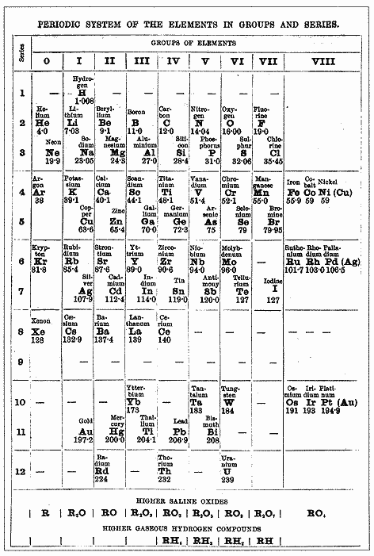
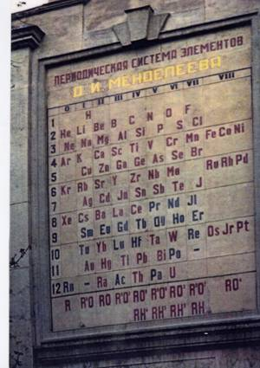
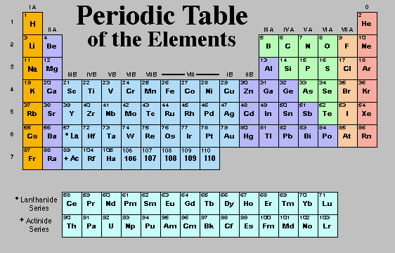
Elementary particles in the 19th century
The Atoms of the 92 Elements
1. Hydrogen Mass M_{H} ≈ 1.7 x 10⁻²⁴ g
2. Helium
3. Lithium
…
…
92. Uranium M_{U} ≈ 238 M_{H}
Mendeleev produces periodic table ~1870
St. Petersburg, Russia

Slide 6
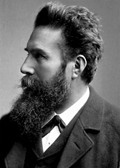
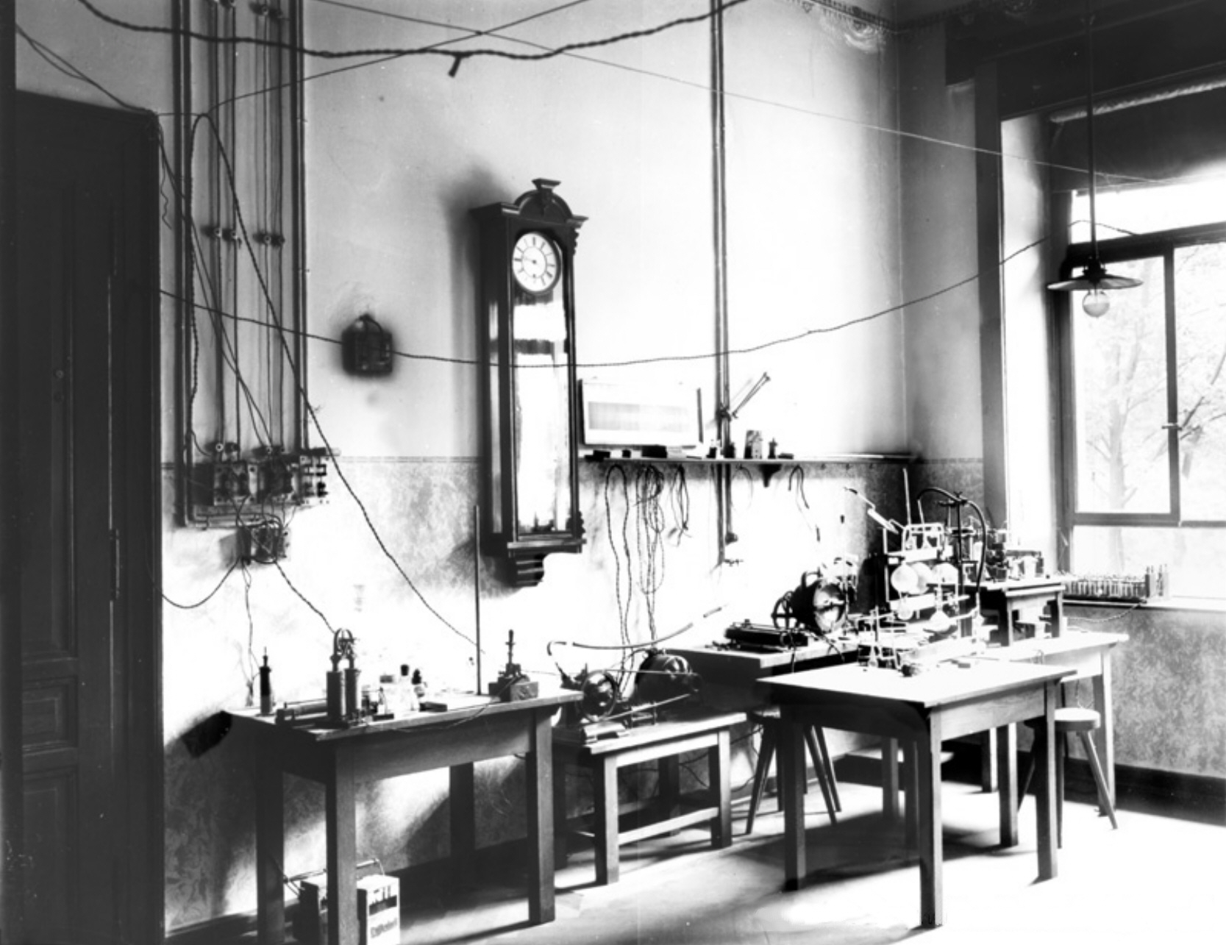
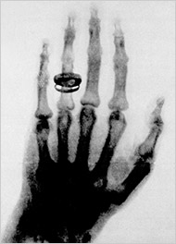
Discovery of X-rays
W. Röntgen in 1895, accidentally discovers X-rays while experimenting with electron beams in a gas discharged tube
Noticed a fluorescent glow when the electron beam was turned on
Asks wife to put hand in front of tube
W. Röntgen
PhD Univ. of Zurich
1895, laboratory at the University of Wurzburg
New York Times article
X-Rays, 1896

Slide 7
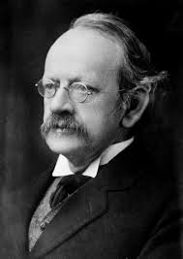
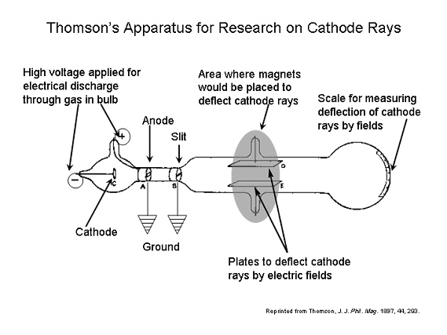
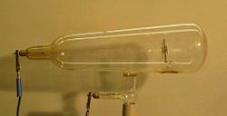

Discovery of the electron
Crookes tube
J. J. Thomson, 1897 - Cavendish Laboratory at Cambridge University
Studying cathode rays: electric current in tubes at very low gas pressure observes a glow discharge
Measurement of the electron mass: m_{e} ≈ M_{H}/1836
J. J. Thomson
"To the electron -- may it never be of any use to anybody." – J. J. Thomson's favorite toast
ATOMS ARE NOT ELEMENTARY
Thomson’s atomic model:
Electrically charged sphere
Radius ~ 10⁻⁸ cm
Positive electric charge
Electrons with negative electric charge embedded in the sphere

Slide 8
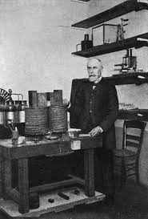
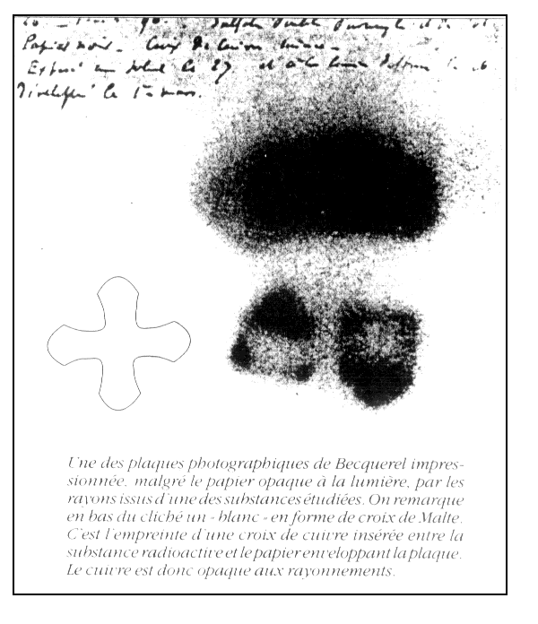
Discovery of natural radioactivity
H. Becquerel, 1896 - France
Working with naturally fluorescent minerals to study the properties of x-rays
Accidentally discovers that photographic plates became exposed by radiation from uranium salts
H. Becquerel
Image formed by Becquerel on photographic paper

Slide 9
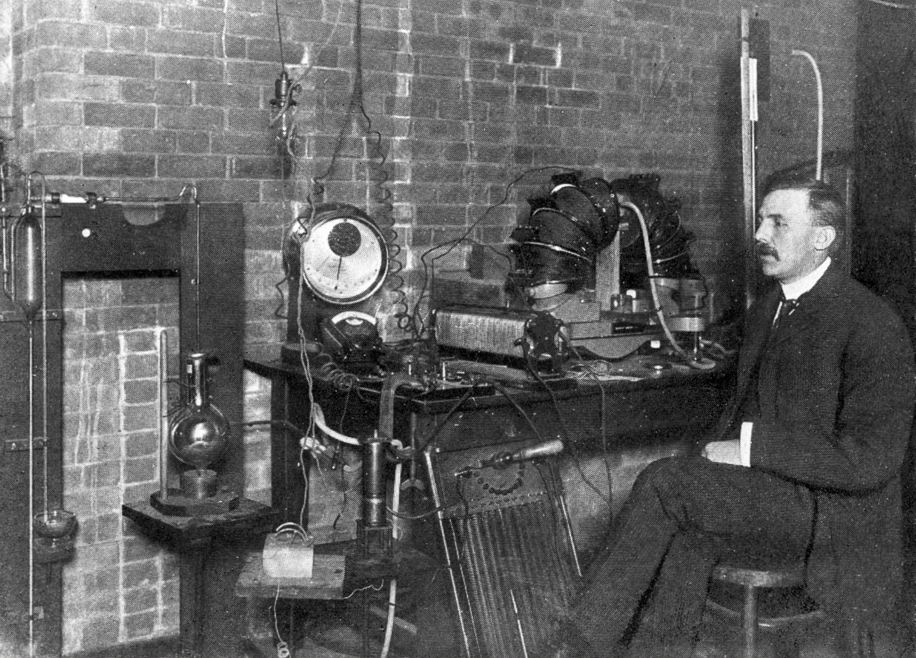
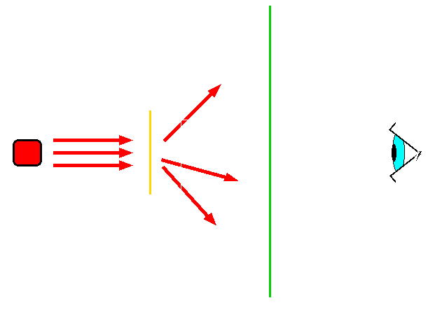
Discovery of the atomic nucleus
E. Rutherford, 1909-13, at the University of Manchester creates experiments with alpha particles: Rutherford’s scattering experiments
a-particles: nuclei of Helium atoms spontaneously emitted by heavy radioactive isotopes
Typical a–particle velocity ≈ 0.05 c (c : speed of light)
E. Rutherford
fluorescent
screen
α − particles
radioactive
source
target
(very thin Gold foil)
Detector
(human eye)

Slide 10
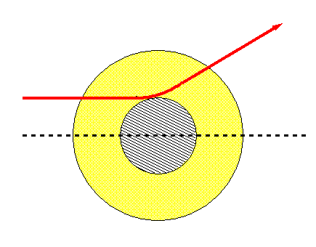
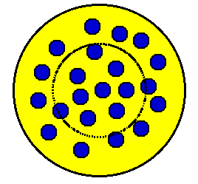
Discovery of the atomic nucleus
α – atom scattering at low energies is dominated by Coulomb interaction
α − particle
Atom: spherical distribution
of electric charges
impact
parameter
b
α – particles with impact parameter = b “see” only electric charge within
sphere of radius = b (Gauss theorem for forces proportional to r⁻² )
For Thomson’s atomic model
the electric charge “seen” by the
α – particle is zero, independent
of impact parameter
⇒ no significant scattering at large angles is expected

Slide 11
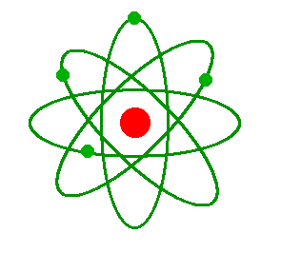
Discovery of the atomic nucleus
Rutherford’s observation:
significant scattering of α – particles at large angles, consistent with scattering
expected for a sphere of radius ≈ few x 10⁻¹³ cm
and electric charge = Ze, with Z = 79 (atomic number of gold)
and e = |charge of the electron|
an atom consists of
a positively charged nucleus
surrounded by a cloud of electrons
Nuclear radius ≈ 10⁻¹³ cm ≈ 10⁻⁵ x atomic radius
Mass of the nucleus ≈ mass of the atom
(to a fraction of 1‰ )

Slide 12
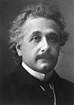
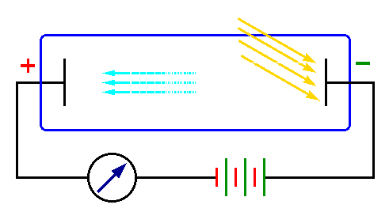
Light consists of particles
Photoelectric effect
glass tube under vacuum
A. Einstein
PhD Univ. Zurich
Current
measurement
Experimental observation of a threshold effect as a function of the frequency of the light
impinging onto the electrode at negative voltage (cathode):
Frequency ν < ν₀ : electric current = zero, independent of luminous flux;
Frequency ν > ν₀ : current > 0, proportional to luminous flux
Einstein’s interpretation:
Light consists of particles (“photons”)
Photon energy proportional to frequency:
Threshold energy E₀ = hν₀: the energy needed to extract
an electron from an atom (depends on the cathode material)
E = h ν (Planck constant h = 6.626 x 10 ⁻³⁴ J s)

Slide 13
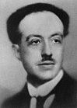
Waves and particles
All matter particles possess both the
properties of waves and particles
Relation between wavelength and momentum:
h
p
L. de Broglie
λ =
h: Planck constant
p = m v : particle momentum
Hypothesis soon confirmed by the observation of diffraction pattern in the scattering of electrons from crystals, confirming the wave behaviour of electrons (Davisson and Germer, 1927)
Wavelength of the α – particles used by Rutherford in the discovery of
the atomic nucleus:
α−particle
mass
~ resolving power
of Rutherford’s
experiment
0.05 c

Slide 14
Before 1932
First (wrong) ideas about nuclear structure
Observations
Mass values of light nuclei ≈ multiples of proton mass (to few %)
(proton ≡ nucleus of the hydrogen atom)
β decay: spontaneous emission of electrons by some radioactive nuclei
Hypothesis: the atomic nucleus is a system of protons and electrons strongly bound together
Nucleus of the atom with atomic number Z and mass number A:
a bound system of A protons and (A – Z) electrons
Total electric charge of the nucleus = [A – (A – Z)]e = Z e
Problem with this model: the “Nitrogen anomaly”

Slide 15
Before 1932 – nitrogen anomaly
Spin: intrinsic angular momentum of a particle (or system of particles)
In Quantum Mechanics only integer or half-integer multiples of ħ ≡ (h / 2π)
are possible:
integer values for orbital angular momentum (e.g., for the motion of atomic electrons around the nucleus)
both integer and half-integer values for spin
Electron, proton spin = ½ħ (measured)
Nitrogen nucleus (A = 14, Z = 7): 14 protons + 7 electrons = 21 spin ½ particles
TOTAL SPIN MUST HAVE HALF-INTEGER VALUE
Measured spin = 1 (from hyperfine splitting of atomic spectral lines)

Slide 16
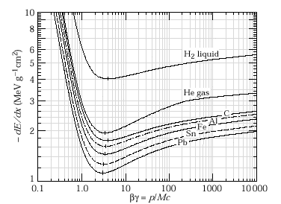
Basic principles of particle detection
Passage of charged particles through matter
Interaction with atomic electrons
ionization
(neutral atom → ion⁺ + free electron)
excitation of atomic energy levels
(de-excitation → photon emission)
Ionization + excitation of atomic energy energy loss
Mean energy loss rate –dE /dx
proportional to (electric charge)²
of incident particle
for a given material, function only
of incident particle velocity
typical value at minimum:
−dE /dx = 1 – 2 MeV /(g cm⁻²)
NOTE: traversed thickness (dx) is given in g /cm² to be independent of material density (for variable density materials, such as gases) – multiply dE /dx by density (g/cm³) to obtain dE /dx in MeV/cm

Slide 17
Residual range
Residual range of a charged particle with initial energy E₀
losing energy only by ionization and atomic excitation:
M: particle rest mass
v: initial velocity
the measurement of R for a particle of known rest mass M
is a measurement of the initial velocity
Passage of neutral particles through matter: no interaction with atomic electrons
⇒ detection possible only in case of collisions producing charged particles

Slide 18
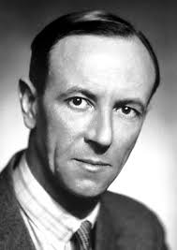
Discovery of the neutron
J. Chadwick, 1932 -Cavendish laboratory at Cambridge University
Neutron: a particle with mass ≈ proton mass but with zero electric charge
Solution to the nuclear structure problem:
Nucleus with atomic number Z and mass number A: a bound system of Z protons and (A – Z) neutrons
J. Chadwick
Nitrogen anomaly: no problem if neutron spin = ½ħ
Nitrogen nucleus (A = 14, Z = 7): 7 protons, 7 neutrons = 14 spin ½ particles
⇒ total spin has integer value

Slide 19
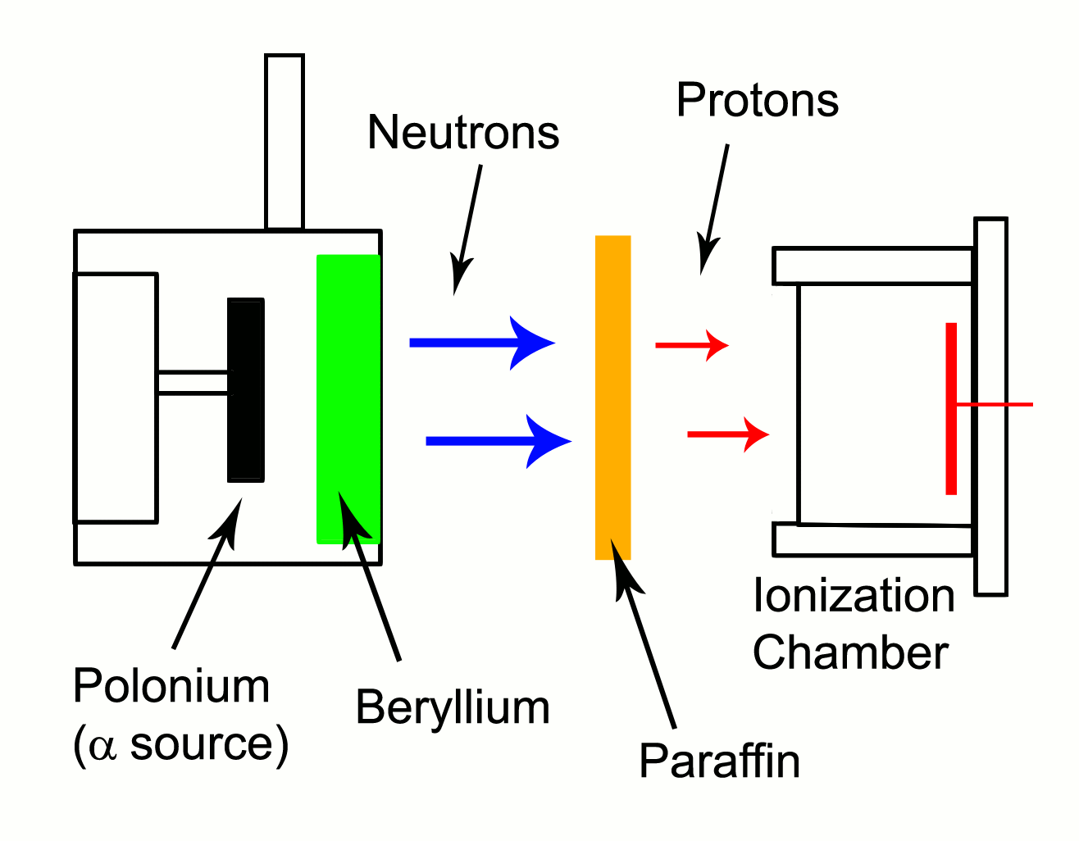
Discovery of the neutron
Neutron source in Chadwick's experiments: a ²¹⁰Po radioactive source
(5 MeV α – particles ) mixed with Beryllium powder ⇒ emission of
electrically neutral radiation capable of traversing several centimetres of Pb:
⁴He₂ + ⁹Be₄ → ¹²C₆ + neutron
↑
α - particle
An old gaseous detector based on an expanding vapour; ionization acts as seed for the formation of liquid drops. Tracks can be photographed as strings of droplets

Slide 20
Discovery of the neutron
Neutron source in Chadwick's experiments: a ²¹⁰Po radioactive source
(5 MeV α – particles ) mixed with Beryllium powder ⇒ emission of
electrically neutral radiation capable of traversing several centimetres of Pb:
⁴He₂ + ⁹Be₄ → ¹²C₆ + neutron
↑
α - particle
Neutron discovery:
observation and measurement of nuclear recoils in an “expansion chamber”
filled with Nitrogen at atmospheric pressure
scattered neutron
(not visible)
incident
neutron
(not visible)
recoil nucleus
(visible by ionization)

Slide 21
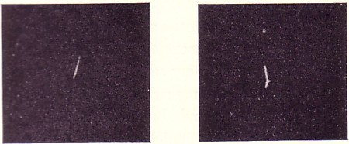
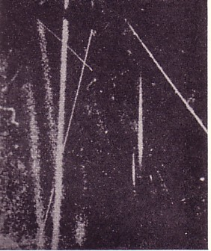
Incident
neutron
direction
Plate containing
free hydrogen
(paraffin wax)
Recoiling Nitrogen nuclei
proton tracks ejected
from paraffin wax
Assume that incident neutral radiation consists
of particles of mass m moving with velocities v < V_{max}
Determine max. velocity of recoil protons (U_{p}) and Nitrogen nuclei (U_{N})
from max. observed range
2m
m + m_{p}
2m
m + m_{N}
From non-relativistic energy-momentum
conservation
m_{p}: proton mass; m_{N}: Nitrogen nucleus mass
U_{p} = V_{max}
U_{N} = V_{max}
U_{p} m + m_{N}
U_{N} m + m_{p}
From measured ratio U_{p} / U_{N} and known values of m_{p}, m_{N}
determine neutron mass: m ≡ m_{n} ≈ m_{p}
=
Present mass values : m_{p} = 938.272 MeV/c²; m_{n} = 939.565 MeV/c²

